Slide 1
Superstore Sales Performance Dashboard
Microsoft Power BI Dashboard
Prepared by Chisom Nwangele
AnalystLab Africa Internship Week 4

Slide 2
Dataset Overview
Dataset : Superstore Sales Dataset
Tool : Microsoft Power BI
Description:
Sales transactions from a retail superstore.
Includes sales, profit, quantity, customers, products and regions.
Used to analyze sales performance and business trends.

Slide 3

Business Problem
Many businesses generate large amounts of sales but struggle to turn it into useful insights for better decision-making.
Project Objectives
Analyze overall sales performance.
Identify the most profitable regions and product categories.
Monitor monthly sales trend.
Build an interactive Power BI dashboard to support business decisions.

Slide 4



Key Performance Indicators (KPIs)
The dashboard focuses on the following key business Metrics:
Total Sales: 2.30M
Total Profit: 286.40k
Total Quantity Sold: 38k
Total Orders: 5,009
These KPIs provide a quick overview of overall business performance.

Slide 5
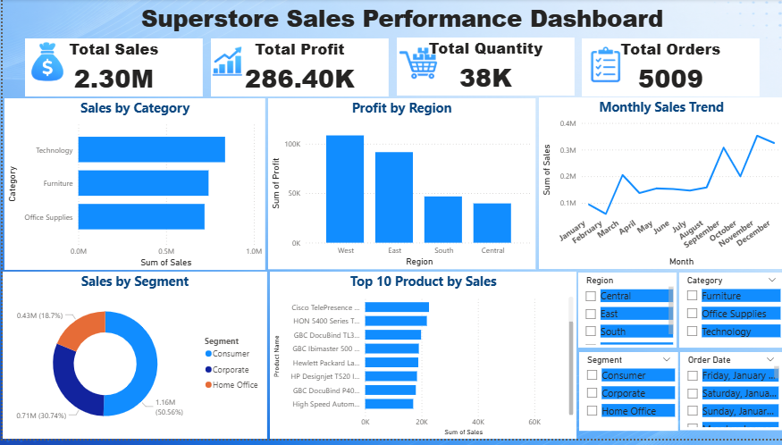
Dashboard Overview
The dashboard combines KPIs cards, charts, and slicers to present sales performance in a clear and interactive way.
Users can filter the dashboard by Region, Category, Segment, and Order Date to explore specific business insights.

Slide 6
Key Insights
Technology category recorded the highest sales among all product categories.
The West region generated the highest overall profit.
The Consumer segment contributed the largest share of total sales.
Monthly sales increased toward the end of the year, showing stronger business performance.

Slide 7
Recommendations
Increase investment in high-performing product categories, especially Technology
Develop strategies to improve sales in lower-performing regions
Continue monitoring monthly sales trends to support better planning and forecasting.
Use the dashboard regularly to support data-driven decision-making.

Slide 8
Challenges
Learning Power BI dashboard design and formatting.
Creating a clean and visually appealing dashboard layout.
Selecting the most relevant KPIs and visualizations.

Slide 9
Conclusion
This dashboard successfully analyzes the Superstore Sales dataset using Microsoft Power BI
The interactive dashboard provides clear insights into sales, profit, quantity, and order performance across different regions and categories
Overall, the project demonstrates how data visualization can support better business decisions through clear and interactive reporting

